Slide 1
Module 5.2
Longest Common Subsequence

Slide 2
Subsequences
Suppose you have a sequence
X = < x₁,x₂,…,x_{m}>
of elements over a finite set S.
A sequence Z = < z₁,z₂,…,z_{k}> over S is called a subsequence of X if and only if it can be obtained from X by deleting elements.
Put differently, there exist indices i₁<i₂ <…<i_{k} such that
z_{a} = x_{ia}
for all a in the range 1<= a <= k.

Slide 3
Subsequences
In mathematics, a subsequence of a given sequence is a sequence that can be derived from the given sequence by deleting some or no elements without changing the order of the remaining elements.
For example, the sequence <A,B,D> is a subsequence of <A,B,C,D,E,F> obtained after removal of elements C,E and F
The list of all subsequences for the word "apple" would be "a", "ap", "al", "ae", "app", "apl", "ape", "ale", "appl", "appe", "aple", "apple", "p", "pp", "pl", "pe", "ppl", "ppe", "ple", "pple", "l", "le", "e", " " (empty string).

Slide 4
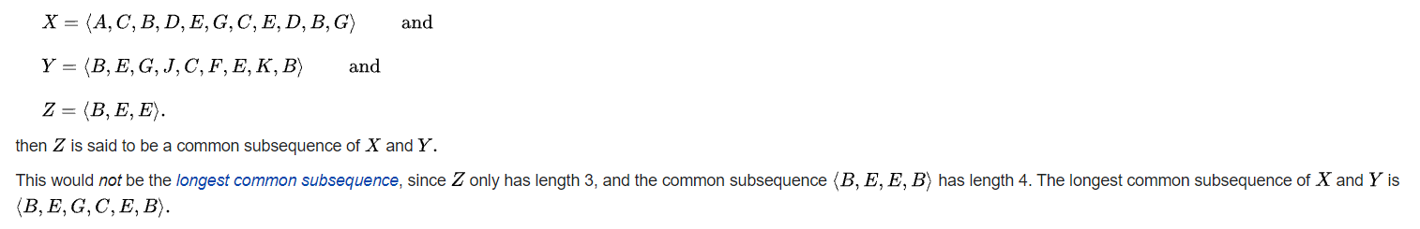
Common Subsequences
Suppose that X and Y are two sequences over a set S.
We say that Z is a common subsequence of X and Y if and only if
Z is a subsequence of X as well as Y

Slide 5
The Longest Common Subsequence Problem
Given two sequences X and Y over a set S, the longest common subsequence problem asks to find a common subsequence of X and Y that is of maximal length.
String 1: abcdefghij
String 2: cdgi
The LCS problem is finding whether the set of characters in two strings are matching or not. The matching characters need not be continuous.
There can be multiple longest common subsequences.
String 1: abdace
String 2: babce

Slide 6
Naïve Solution
Let X be a sequence of length m,
and Y a sequence of length n.
Check for every subsequence of X whether it is a subsequence of Y, and return the longest common subsequence found.
There are 2^{m} subsequences of X.
Testing a sequences whether or not it is a subsequence of Y takes O(n) time. Thus, the naïve algorithm would take O(n2^{m}) time.

Slide 7
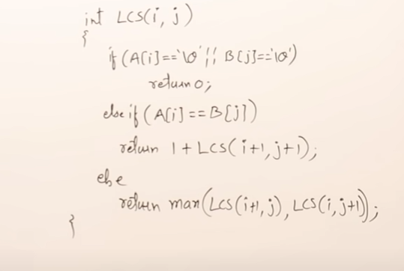
LCS using Recursion

Slide 8


LCS Using Recursion(top down)
A[0],B[0]
b,a
2
A[1],B[0]
d,a
1
A[0],B[1]
b,b
2
1+
A[1],B[2]
d,c
1
A[2],B[0]
\0,a
A[1],B[1]
d,b
1
0
A[2],B[1]
\0,b
A[1],B[2]
d,c
1
A[2],B[2]
\0,c
A[1],B[3]
d,d
1
Recursive Algorithm
0
1+
A[2],B[4]
\0,\0
0
0
A[2],B[2]
\0,c
A[1],B[3]
d,d
A[2],B[2]
\0,c
A[1],B[3]
d,d
1
Exponential Time taking algorithm
0
1+
A[2],B[4]
\0,\0
0

Slide 9
Using Memoization Method(Top Down)
A[0],B[0]
b,a
2
a b c d \0
0 1 2 3 4
b 0
d 1
\0 2
2 | 2
1 | 1 | 1 | 1
0 | 0 | 0 |  | 0
A[1],B[0]
d,a
1
A[0],B[1]
b,b
2
1+
A[1],B[2]
d,c
1
O(m x n)
A[2],B[0]
\0,a
A[1],B[1]
d,b
1
0
A[2],B[1]
\0,b
A[1],B[2]
d,c
1
A[2],B[2]
\0,c
A[1],B[3]
d,d
1
0
1+
A[2],B[4]
\0,\0
0
0
A[2],B[2]
\0,c
A[1],B[3]
d,d
A[2],B[2]
\0,c
A[1],B[3]
d,d
1
0
1+
A[2],B[4]
\0,\0
0

Slide 10
LCS using Dynamic Programming Approach(Tabular Method-Bottom Up approach)
Algorithm: LCS(i,j)
if (A[i]==B[j]) // If match, then add 1 to the value from previous diagonal element
LCS[i,j]=1+LCS[i-1,j-1]
Else // If no match, then take max of previous row element and previous column element of that cell LCS[i,j]=max(LCS[i-1,j],LCS[i,j-1])
a b c d
0 1 2 3 4
0
b 1
d 2
0
0
0
0
0
0
0
1
1
1
0
0
1
1
2
The length of longest common subsequence is 2

Slide 11
LCS using Dynamic Programming Approach(Tabular Method)
Algorithm: LCS(i,j)
if (A[i]==B[j]) // If match, then add 1 to the value from previous diagonal element
LCS[i,j]=1+LCS[i-1,j-1]
Else // If no match, then take max of previous row element and previous column element of that cell LCS[i,j]=max(LCS[i-1,j],LCS[i,j-1])
a b c d
0 1 2 3 4
0
b 1
d 2
0
0
0
0
0
0
0
1
1
1
0
0
1
1
2
LCS(m,n) = LCS(2,4) gives length of longest common subsequence and LCS here is =bd

Slide 12
Example 2: Str1: stone
Str2 : longest

Slide 13
Example 2: Str1: stone
Str2 : longest
0 | 0 | 0 | 0 | 0 | 0 | 0 | 0
0 | 0 | 0 | 0 | 0 | 0 | 1 | 1
0 | 0 | 0 | 0 | 0 | 0 | 1 | 2
0 | 0 | 1 | 1 | 1 | 1 | 1 | 2
0 | 0 | 1 | 2 | 2 | 2 | 2 | 2
0 | 0 | 1 | 2 | 2 | 3 | 3 | 3

